Slide 1
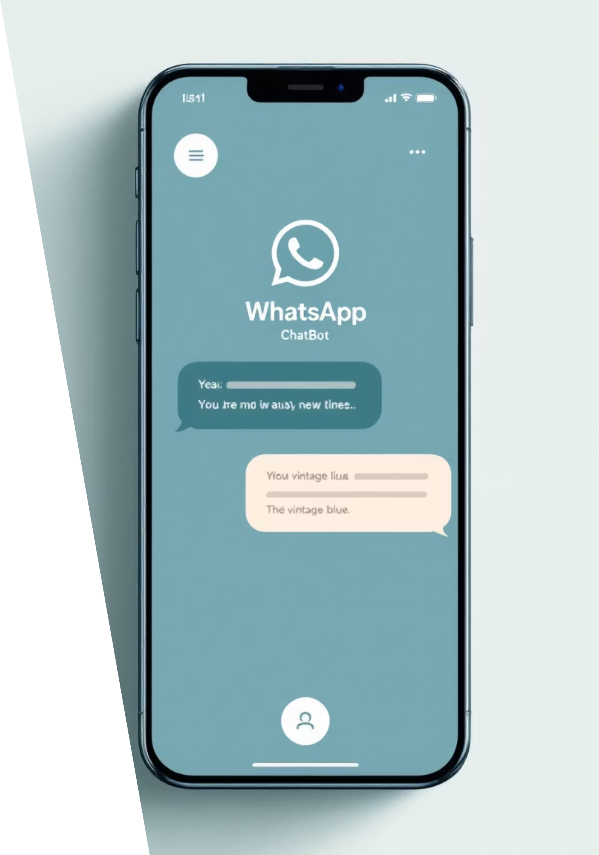
CodeBuddy.AI
Smart Learning Through Automation
An AI-powered WhatsApp bot that generates personalised programming questions instantly, helping students practise coding daily in a conversational way.

Slide 2

The Problem We Solve
The Challenge
Our Solution
Students struggle to find consistent, personalised coding practice opportunities. Traditional platforms are static and lack the conversational engagement students crave.
CodeBuddy.AI delivers AI-generated programming questions directly through WhatsApp—the platform students already use daily. Personalised, instant, and conversational.

Slide 3
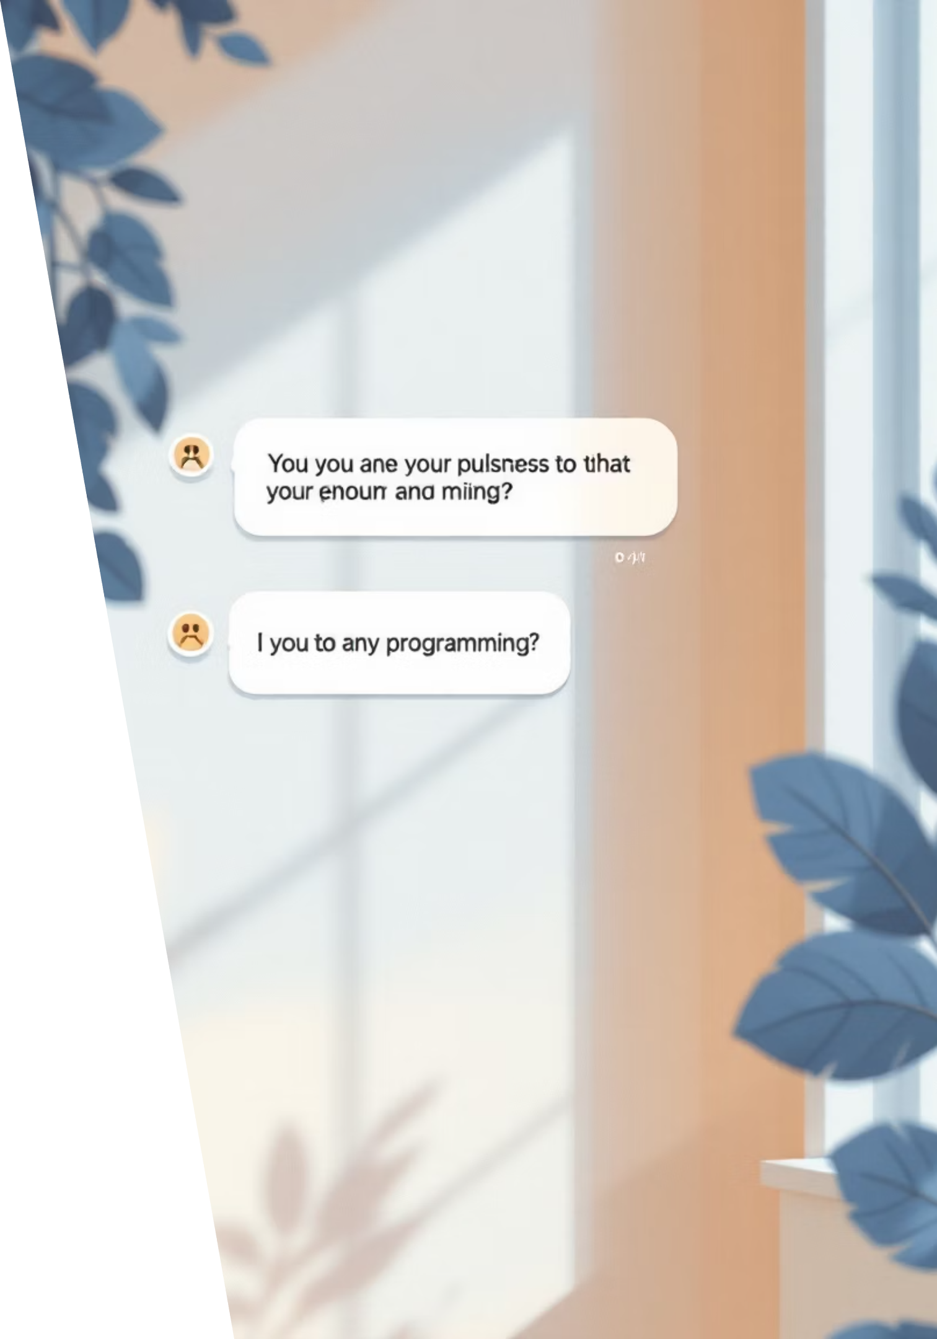
How It Works
01
02
Send a Topic
AI Generates Questions
User messages a programming topic—arrays, recursion, API design—to CodeBuddy on WhatsApp.
Google Gemini creates three contextual, progressively challenging coding questions tailored to the topic.
03
Instant Delivery
Questions arrive instantly in WhatsApp, ready for practice. All data is automatically logged for progress tracking.

Slide 4
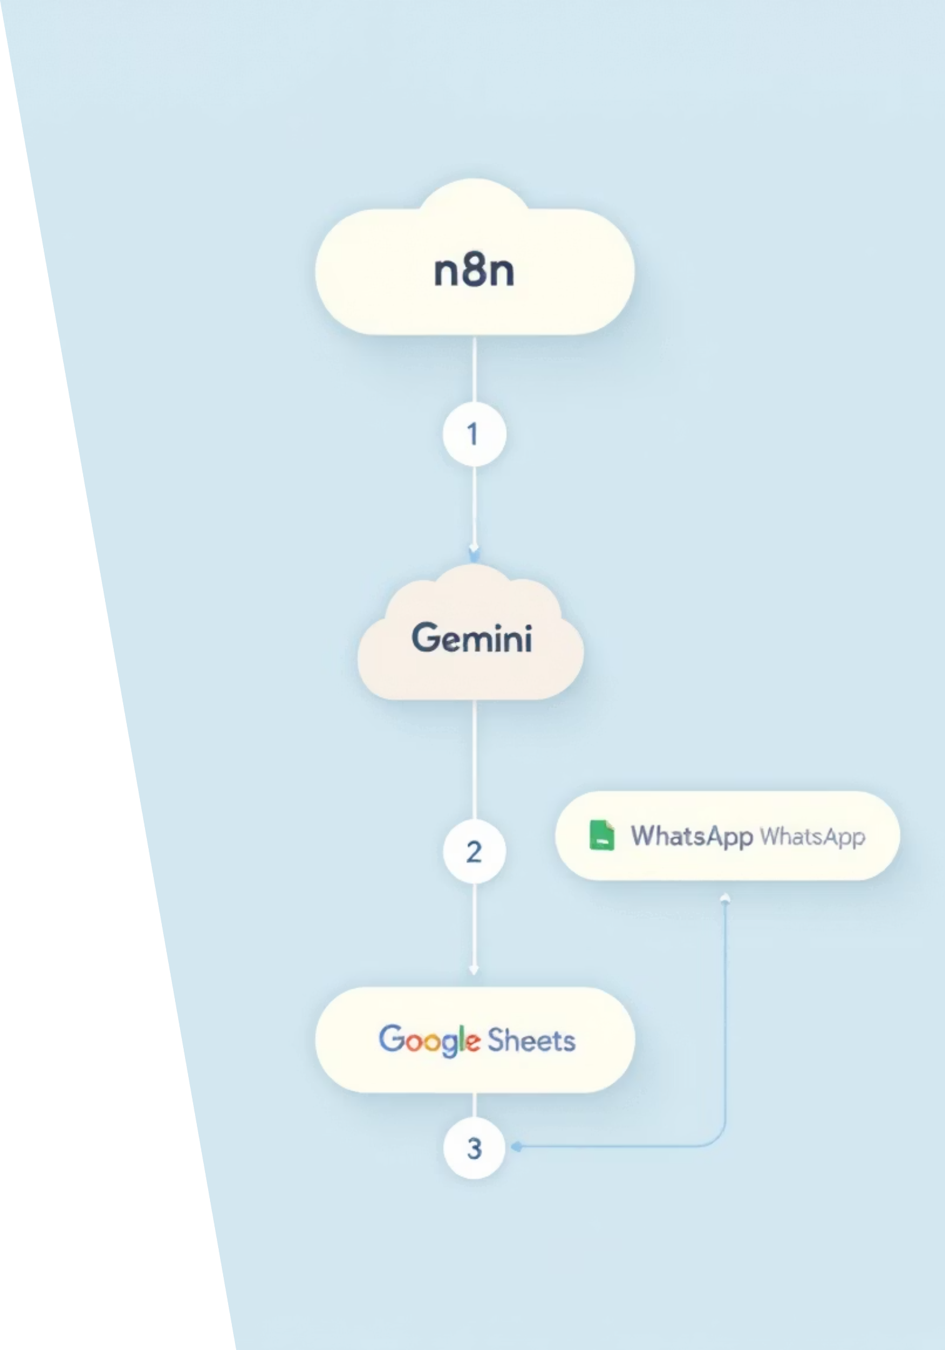
Technology Stack
n8n
Workflow automation orchestrating the entire pipeline with precision.
Google Gemini
Generative AI powering intelligent question creation and contextual learning.
WhatsApp API
Direct user communication channel ensuring accessibility and engagement.
Google Sheets
Scalable data storage capturing all questions and user interactions for analytics.

Slide 5

System Architecture
The workflow seamlessly integrates multiple APIs through n8n's automation engine:
Webhook
Validate
Search
AI Process
Each node is optimised for speed and reliability, ensuring sub-second response times and 99% accuracy in question generation.

Slide 6
Key Features
AI-Driven Generation
WhatsApp Native
Three contextually rich, progressively challenging questions per topic, tailored to learning goals.
Zero friction—students practise where they already spend time, boosting engagement and retention.
Automatic Logging
Infinitely Extensible
Every interaction captured in Google Sheets, enabling progress analytics and future personalisation.
Built for expansion: add scheduled reminders, gamification, multi-language support, or progress dashboards easily.

Slide 7



What's Next
Scheduled Delivery
Daily auto-send coding challenges at optimal learning times.
Model Optimisation
Integrate Gemini Flash and OpenAI for faster, more nuanced responses.
Analytics Dashboard
Real-time progress tracking, skill assessment, and adaptive learning paths.
Built by Varun Sai Mekala
THANK YOU
Empowering learners with AI-driven coding practice, one question at a time.

